Slide 2
Janet
Langhorst
Please feel free to use any resources in this PowerPoint, with proper citation.

Slide 5
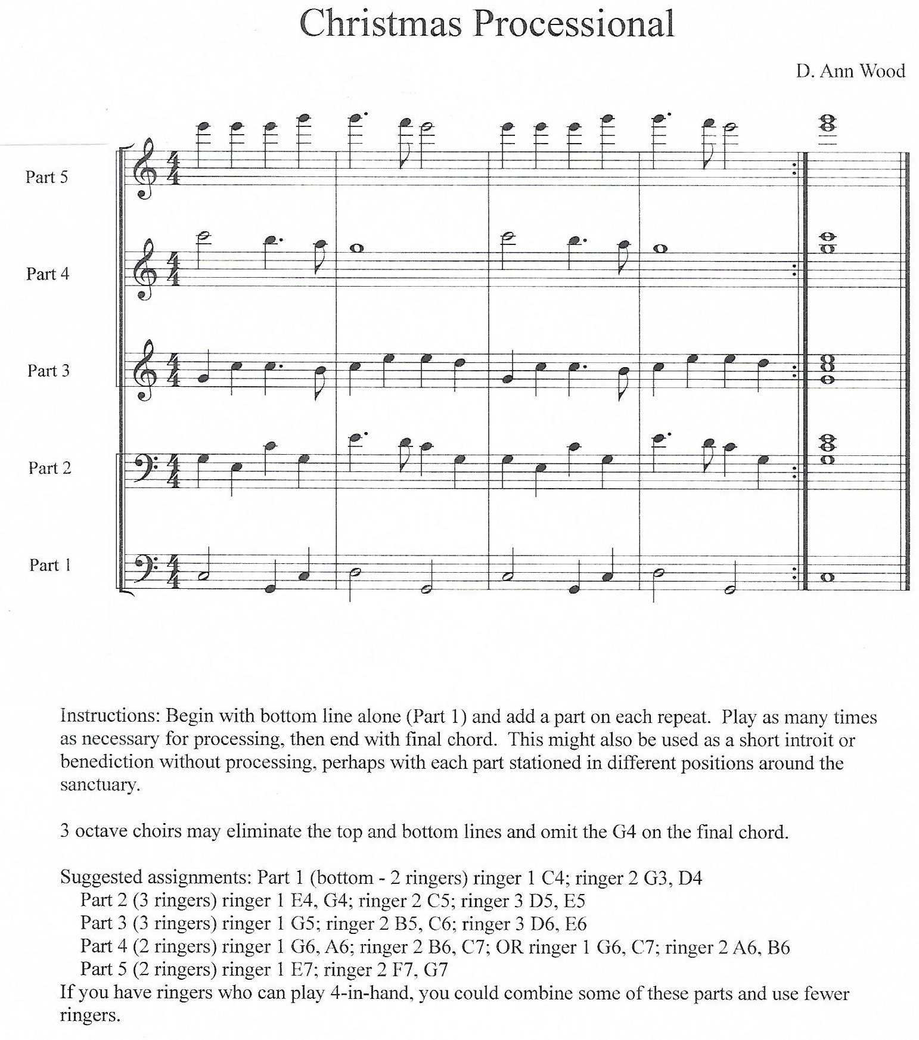

Slide 7
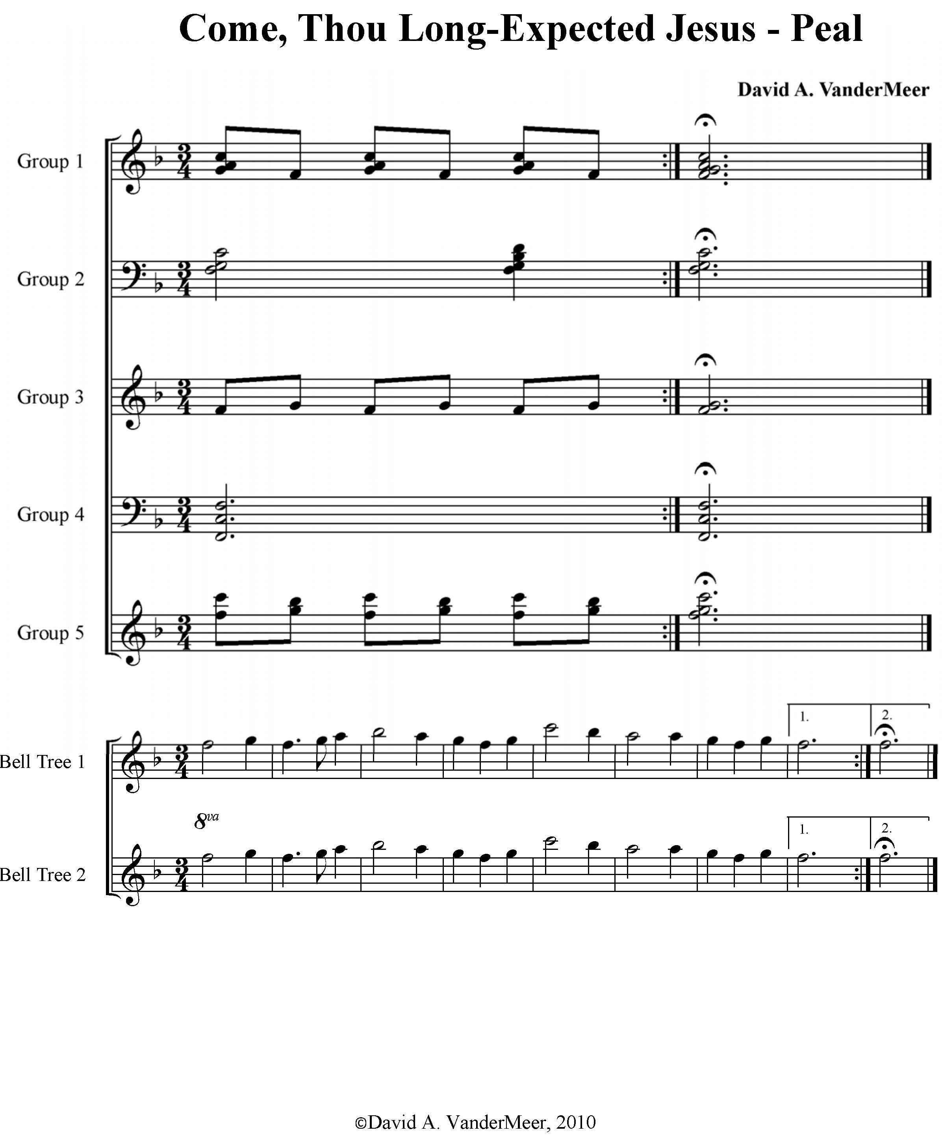

Slide 8
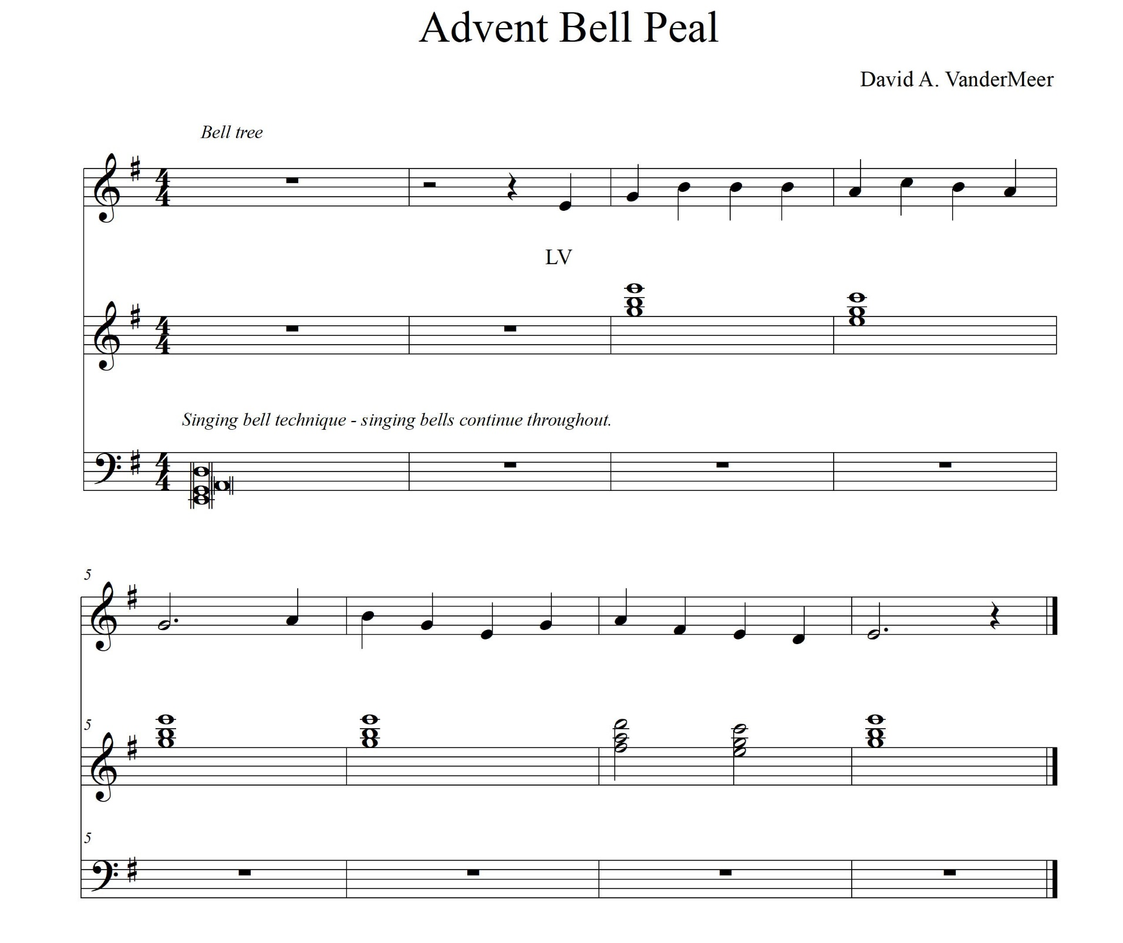

Slide 9
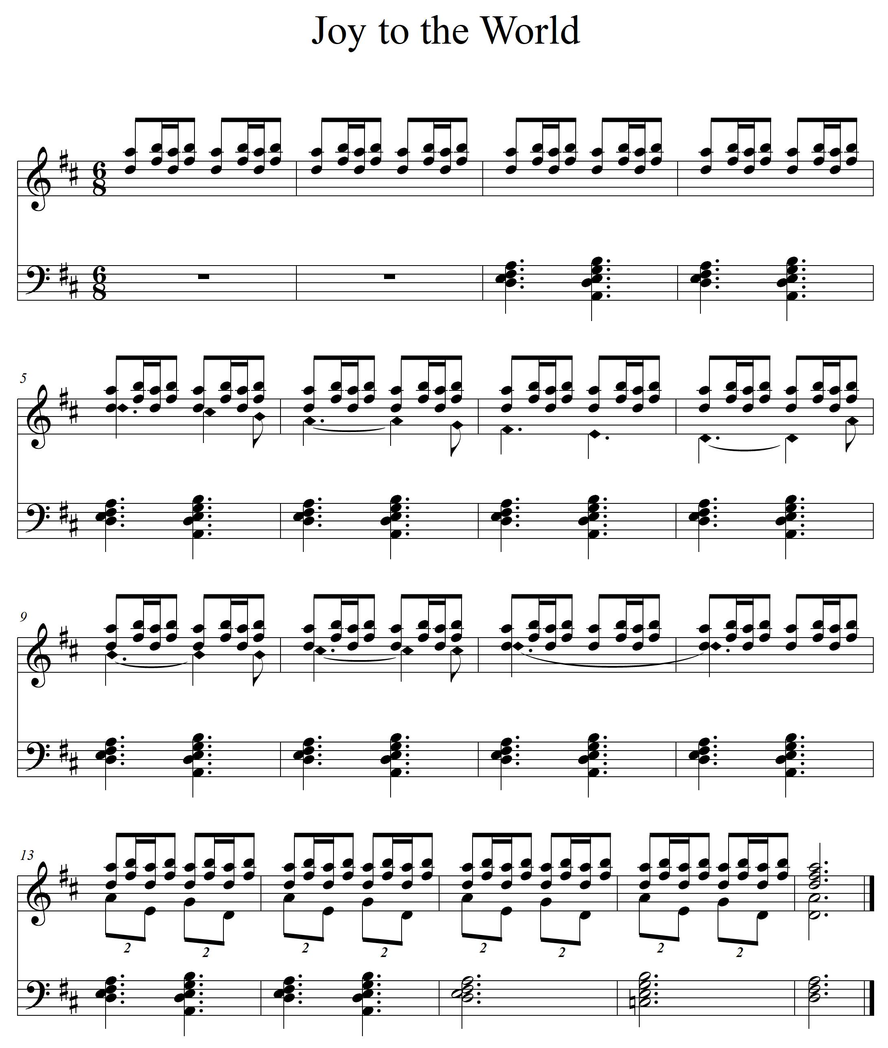
Arr. Brent Ivey and David VanderMeer

Slide 11
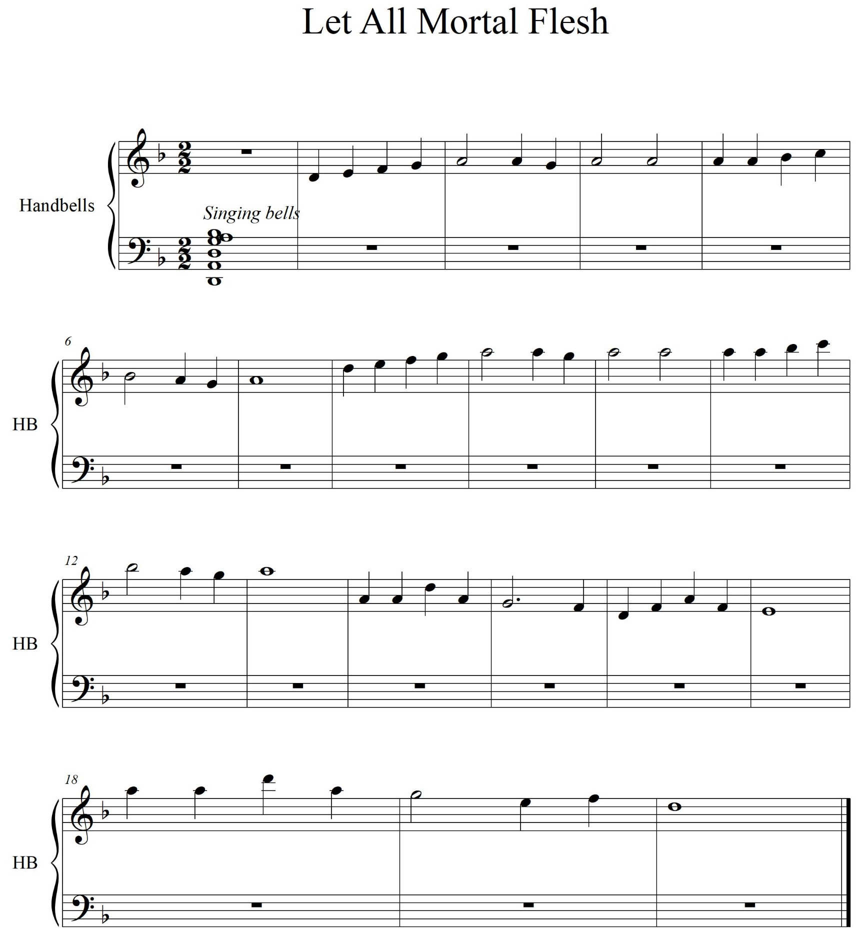

Slide 12
Janet Langhorst jlanghorst@cinci.rr.com David VanderMeer dvandermeer@firstpresbyterian.org Ann Wood dawood82049@gmail.com Please feel free to use any resources in this PowerPoint, with proper citation.
Presenters

